Slide 1

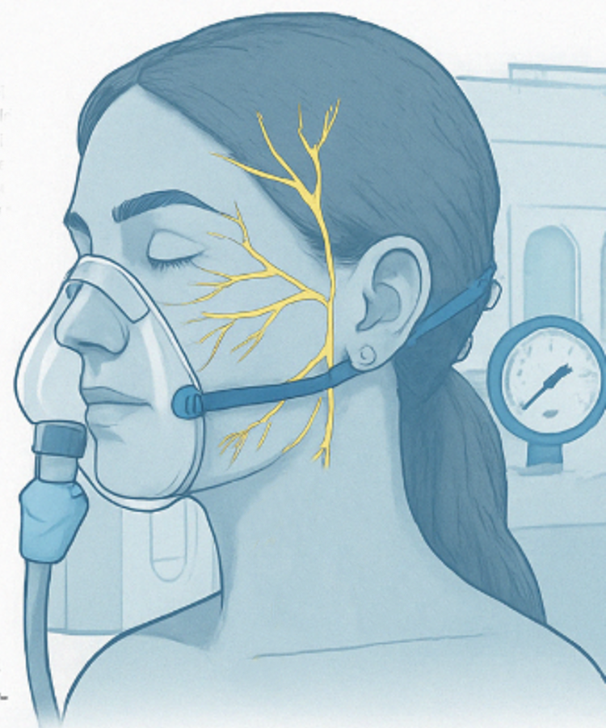
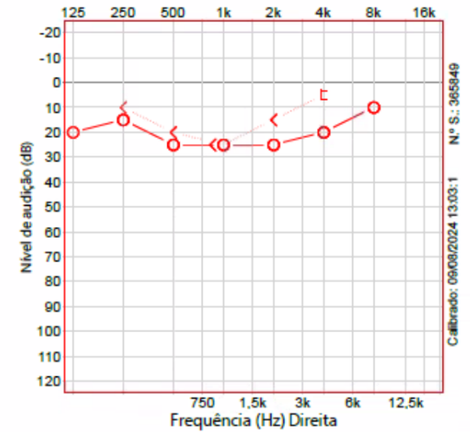
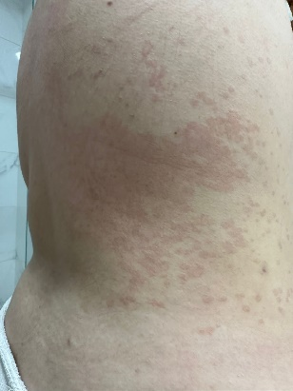

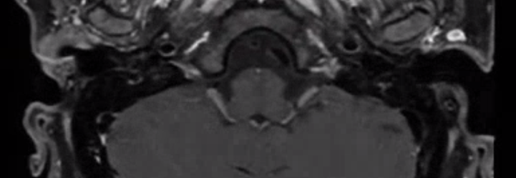
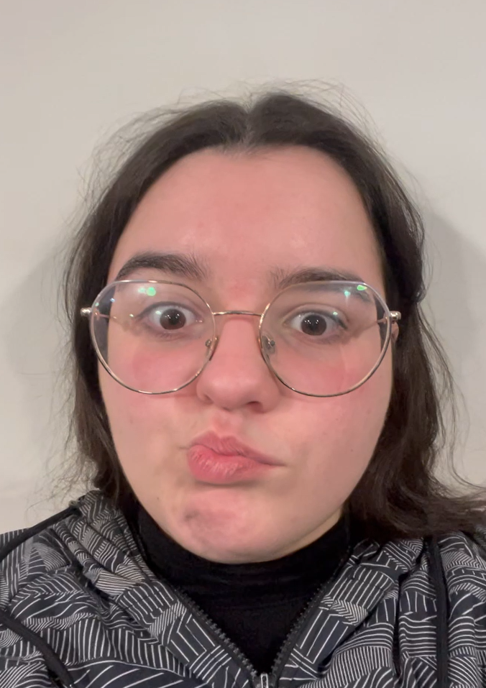
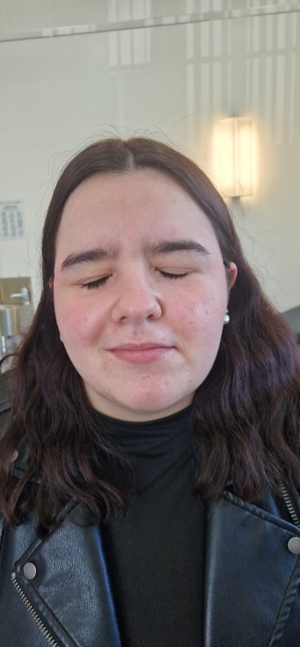
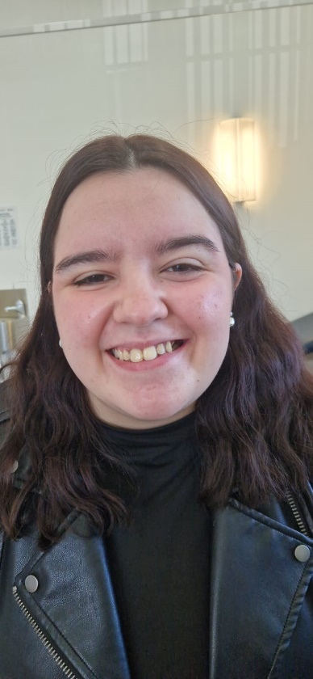
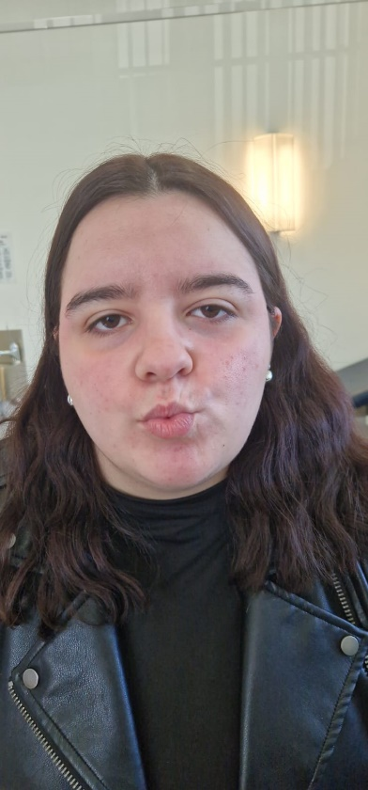
Facial Nerve Palsy:
Pressurize to Decompress?
Sofia Teles^{1,2}, Rafael Terceiro¹, Lília Ferraria², Mariana Neto², Beatriz Paulo³, Rafael Pires², Cláudio Almeida¹,Rute Pereira⁴, Luís Antunes², Diogo Cavalheiro¹
¹Centro de Medicina Subaquática de Hiperbárica, Hospital das Forças Armadas²Hospital Garcia de Orta, Unidade Local de Saúde Almada-Seixal ³Universidade do Algarve, ⁴Hospital do Divino Espirito Santo; Portugal
Introduçtion
Bell’s Palsy
Unilateral peripheric facial palsy
No identifiable cause
Medical treatment: corticoid therapy, eventually anti-viral therapy and neuromuscular rehabilitation
Surgical treatment: facial nerve decompression surgery
  Only in cases of severe degeneration of the facial nerve (without active motor units on eletromyography)
  Technically advanced otologic surgery with multiple complications
  Prolongued recovery (3-6 months)
Material and Methods
♀, 21 year old
Chickenpox in childhood
Intense ear pain of sudden installationI (7/10)
Unilateral right facial palsy
Headache, myalgia and sudden hearing loss
Emergency department:
Right facial palsy House-Brackmann IV
No alterations on otoscopy and slight hearing loss (without criteria for sudden deafness)
Valaciclovir and prednisolone1mg/kg/dia
Rash distributed along multiple thoracic and lumbar dermatomes
1 day later
Fig. 4: Tonal Audiogram at date of diagnosis
1 week later
Fig. 3: Exantema
Fig. 5 – Brain MRI 1 week after diagnosis, showing enhancement in the internal auditory canal, causing compression of both VI and VIII cranial nerves
Fig. 1 and 2: Facial movement at the moment of diagnosis
Results
Ear and Brain MRI: “Signal enhancement involving the distal third of the internal auditory canal (with involvement of the facial–vestibulocochlear nerve complex), extending to the ipsilateral geniculate ganglion, likely related to an infectious process”.
No improvement with treatment
Significant improvement of facial mobility after 4 sessions of Hyperbaric Medicine (House-Brackmann IV -> III).
After 20 sessions House-Brackmann II (Only slight asymmetry on careful inspection).
Discussion
The edema associated with nerve inflammation and the resulting hypoxia of its fibers form the pathophysiological basis of neuropraxia, which is initially reversible but, if prolonged, may lead to Wallerian degeneration. Hyperbaric oxygen therapy may play a facilitating role in reducing edema and shortening recovery time, as well as minimizing motor sequelae in facial paresis, particularly in patients for whom surgical decompression is not indicated.
Conclusion
In Bell’s palsy of probable viral etiology, particularly in cases with significant asymmetry and no improvement with medical therapy, adjunctive treatment with hyperbaric oxygen therapy may help reduce recovery time and minimize motor sequelae.
Fig. 6, 7 e 8– Pictures after treatment
Bibliographic References:
Toros SZ, Karaca ÇT, Güneş P, Oysu Ç, Ertugay ÇK, Naiboğlu B, Elbüken E, Egeli E. Hyperbaric oxygen versus steroid in facial nerve injury: an experimental animal study. Am J Otolaryngol. 2013 Sep-Oct;34(5):530-6. doi: 10.1016/j.amjoto.2013.06.006. Epub 2013 Jul 26. PMID: 23890702
Zhao Y, Feng G, Gao Z. Advances in diagnosis and non-surgical treatment of Bell's palsy. J Otol. 2015 Mar;10(1):7-12. doi: 10.1016/j.joto.2015.02.003. Epub 2015 Jun 28. PMID: 29937775; PMCID: PMC6002555.
Fieux M, Franco-Vidal V, Devic P, Bricaire F, Charpiot A, Darrouzet V, Denoix L, Gatignol P, Guevara N, Montava M, Roch JA, Tankéré F, Tronche S, Veillon F, Vergez S, Vincent C, Lamas G, Tringali S. French Society of ENT (SFORL) guidelines. Management of acute Bell's palsy. Eur Ann Otorhinolaryngol Head Neck Dis. 2020 Dec;137(6):483-488. doi: 10.1016/j.anorl.2020.06.004. Epub 2020 Jul 4. PMID: 32636146.
Wang L, Shi H. Treatment of traumatic facial paralysis in a child with electroacupuncture and hyperbaric oxygen: A case report. Complement Ther Clin Pract. 2022 Aug;48:101595. doi: 10.1016/j.ctcp.2022.101595. Epub 2022 May 4. PMID: 35588590.
Notes:
Foram colhidas análises clínicas com serologias infecciosas e pesquisa de anticorpos para despiste de doenças auto-imunes, não tendo sido possível identificar agente responsável.
Critérios para surdez neurossensorial súbita são perda de 30dB em 3 frequências contíguas do audiograma com instalação em menos de 72h, medidas na condução óssea (componente neuro-sensorial), pode ter perda da condução aérea e aí é uma surdez de transmissão) – a doente tinha perda auditiva entre 20-25dB em 3 frequências mas não contíguas (125Hz, depois 500Hz e 1k).
Neste caso em particular não rinha indicação cirúrgica pois o local afetado era o canal auditivo interno, local muito pouco acessível por via cirúrgica e considerado de alto risco cirúrgico, pelo que não foi realizada EMG à doente.
Este caso até poderia ter tido uma boa recuperação clínica sem oxigenoterapia hiperbárica, mas nunca no tempo recorde que se verificou (recuperação quase total em menos de um mês), sendo provável que só se verificasse melhoria significativa 4-6 meses depois (após regeneração nervosa) e provavelmente ficaria com mais sequelas

